Slide 1
TubeSat Final Presentation
Shawn Nase, Jimmy Oakes, Zach Cullen, Mark Bright
Electrical Engineering Department
Zoom University

Slide 2

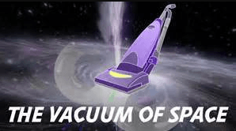
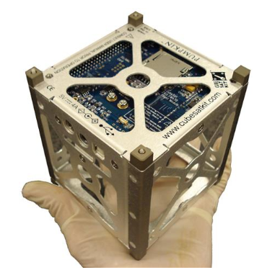
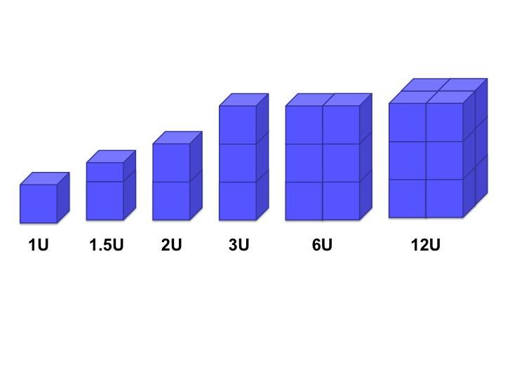
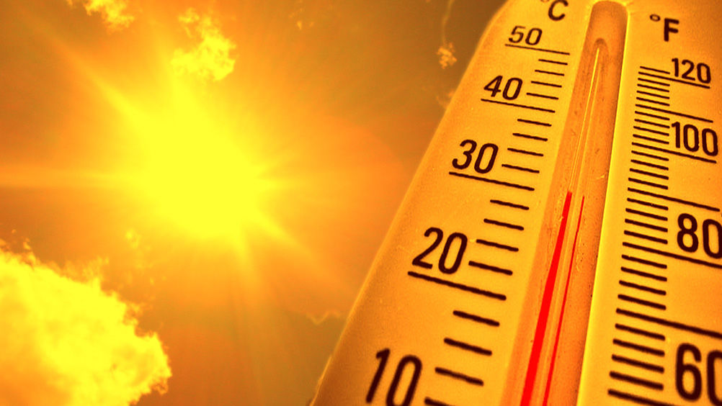
What is a CubeSat?
Small-scale, low cost satellite
Often used in academia and independent research
Directly expose electronics to environmental effects of space
Generally use space rated electronics
12U: 208mm x 208mm x 340.5mm

Slide 3
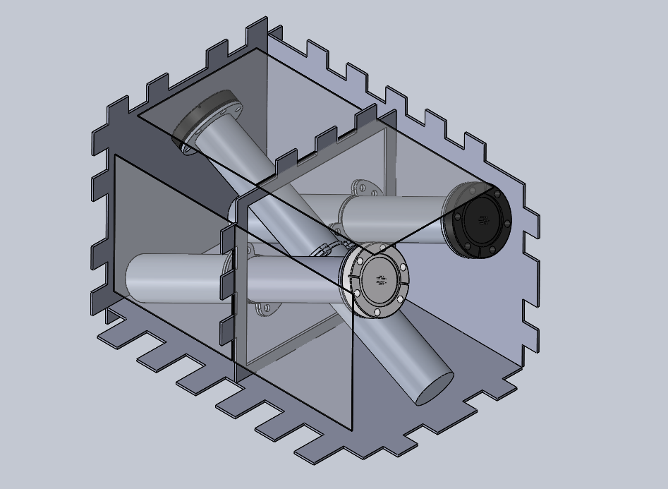
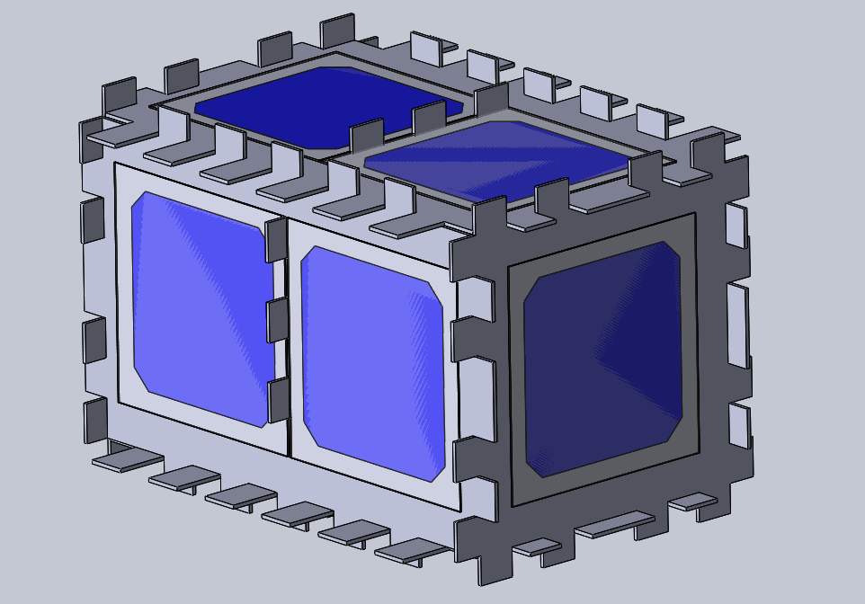
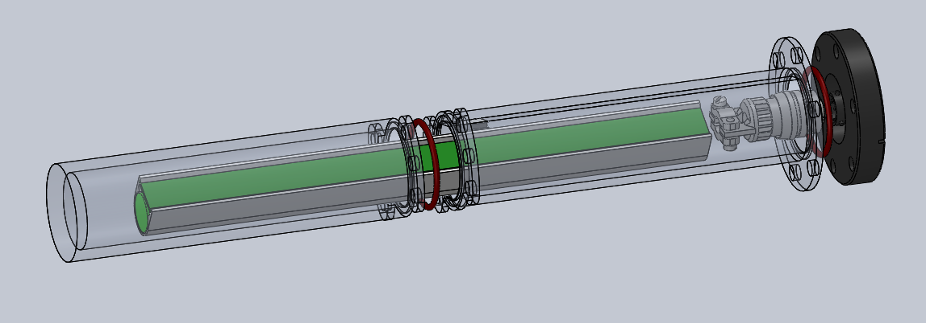
Our Approach: The Tubesat
Open source, low cost, modular satellite design using COTS components
COTS components are not space rated → Must shield against thermal, vacuum, and radiation environment of space
Batteries and electronic modules shielded within tube; power provided via solar cells
Long-term goal: continuously and synchronously blink an LED under simulated environmental conditions; costs below $1500
Short-term goal: provide justification for/against feasibility of design

Slide 4
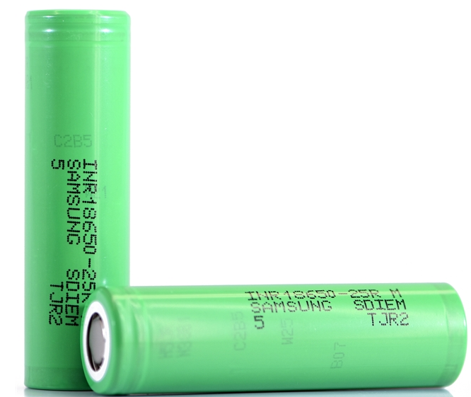
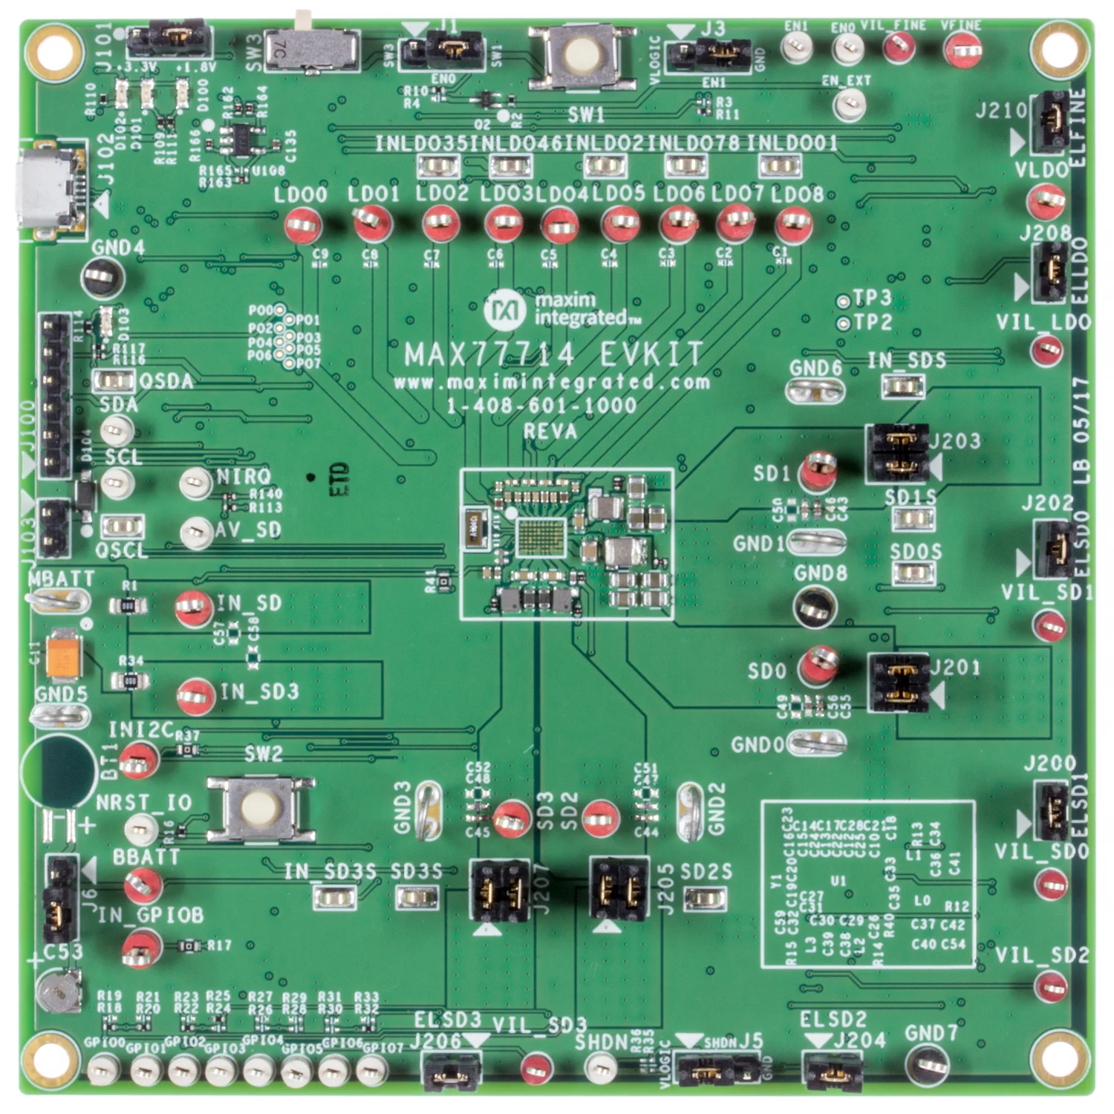

Modules we Need to Shield
Batteries (4)
Power management circuit (PMC)
Digital processing circuit (DPC)

Slide 5
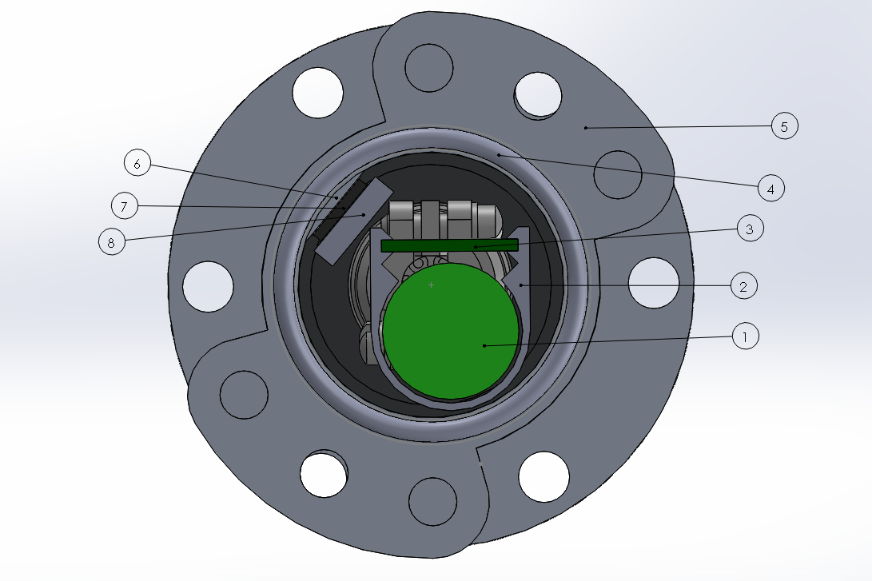
6 - Core Casing TEC Mount Surface
7 - TEC
8 - TEC/Caddy Thermal Coupling Block
1 - Battery Cells
2 - Caddy
3 - PCB
4 - O-Ring
5 - Coupling Flanges

Slide 6
Cost Estimates
Solar cells (10 cells = $35)
Aluminum Sheet 24” X 48” + Cut ($100)
3D Hub Core Case ($459.09)
Feed through ceramic cap($250)
PCB ($200)
PCB Bill of Materials ($150)
Peltier ($75)
Caddy ($60)
ESTIMATED TOTAL - $1345

Slide 7
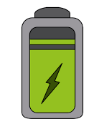
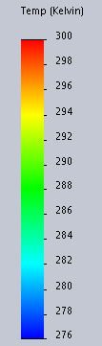

Current Focus
Physical feasibility: electrical and mechanical
Financial and logistical feasibility
Analysis and Simulation Based Approach:
Thermal Modeling and Simulation
Leak Rate Calculations
Power Budgeting

Slide 8
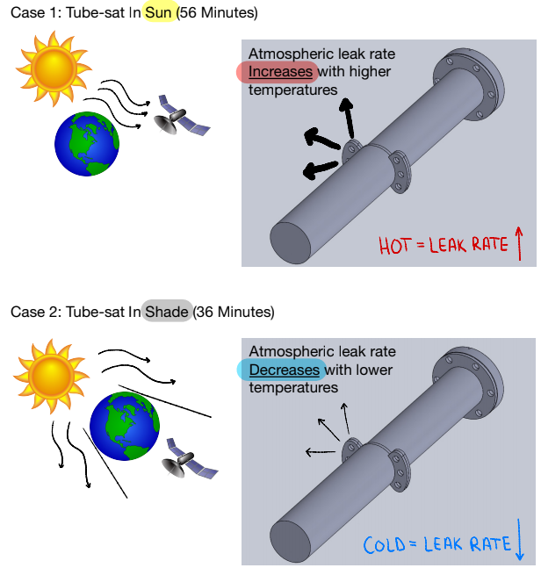
Leak Rate
Leak Rate = 0.7*F*D*P*Q*(S^2)
Variables are permeability and Q-factor
Permeability of silicone directly proportional to temperature, Q-factor dependant on o-ring compression
Permeability of air through silicone o-ring found in Permeability Table
Q-factor is determined by the compression of the o-ring
Worst-case scenario: satellite at constant 72°F → air pressure inside casing roughly 75% of starting air pressure
Air pressure inside casing drops from 14.7 psi to 12.83 psi after six months, above our goal of 12 psi
Site used to calculate leak rate:
https://www.engineersedge.com/fluid_flow/oring_leak_rate_13605.htm

Slide 9
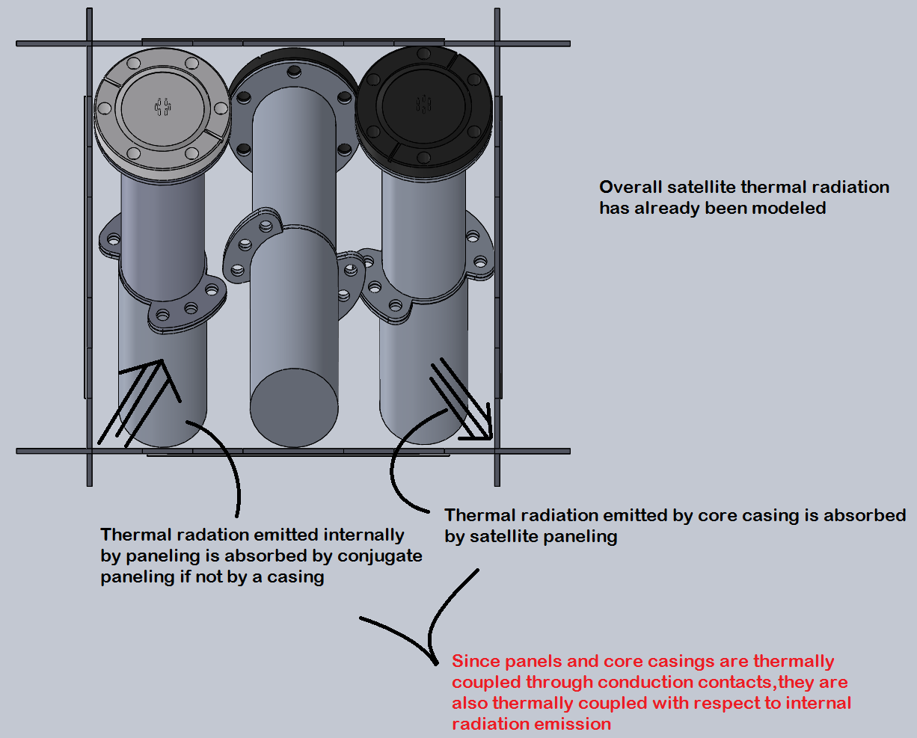
Internal Thermal Radiation Transfer
Thermal energy transfer via radiation within the scope of the 3 dimensional space between the satellite paneling, core casings, and caddies can be ignored
Why?

Slide 10
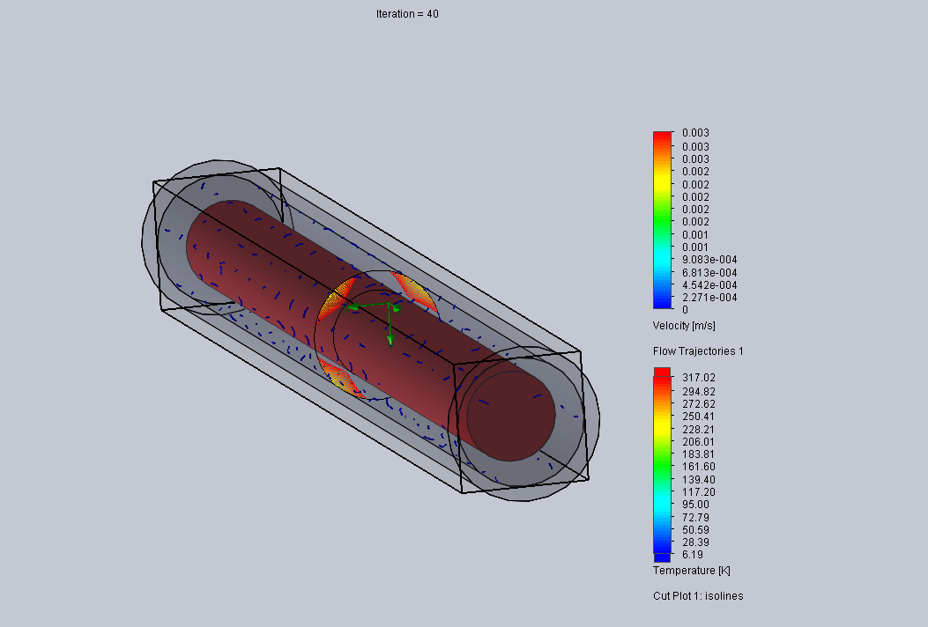
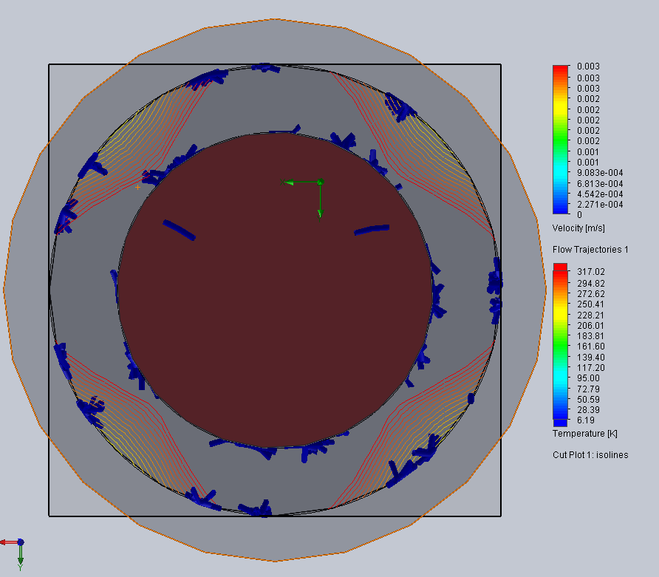
CFD Analysis Results
Velocity of air molecules in fluid subdomain between caddy assumption cylinder and casing assumption cylinder is less than 0.75 in/s
Keep in mind this air velocity is based off exaggerated heat transfer coefficients

Slide 11
Thermal Convection Simulation
Transient thermal transfer over 42 min using air trajectory data from CFD analysis
Simulation Initial Conditions
Heat flux at caddy/air and casing/air interfaces defined as 15 W/m^2 (Worst case scenario)
Casing and caddy rotated through several temperature differentials
Caddy or casing set as infinite heat source or bottomless heat sink
Results in data for worst case scenario

Slide 12
Thermal Convection Results
Negligible heat transfer, i.e. convection can be ignored
Casing T (F) | Caddy T (F) | Time (s) | Transfer (J) | Direction
-100 L | 70 UL | 2520 s | 6.1608E-12 Joules | Ca to CC
-100 L | 30 UL | 2520 s | 8.4621E-12 Joules | Ca to CC
-100 L | -15 UL | 2520 s | 1.5183E-12 Joules | Ca to CC
70 L | -100 UL | 2520 s | 5.4865E-12 Joules | CC to Ca
30 L | -100 UL | 2520 s | 5.4865E-12 Joules | CC to Ca
-15 L | -100 UL | 2520 s | 5.4865E-12 Joules | CC to Ca

Slide 13
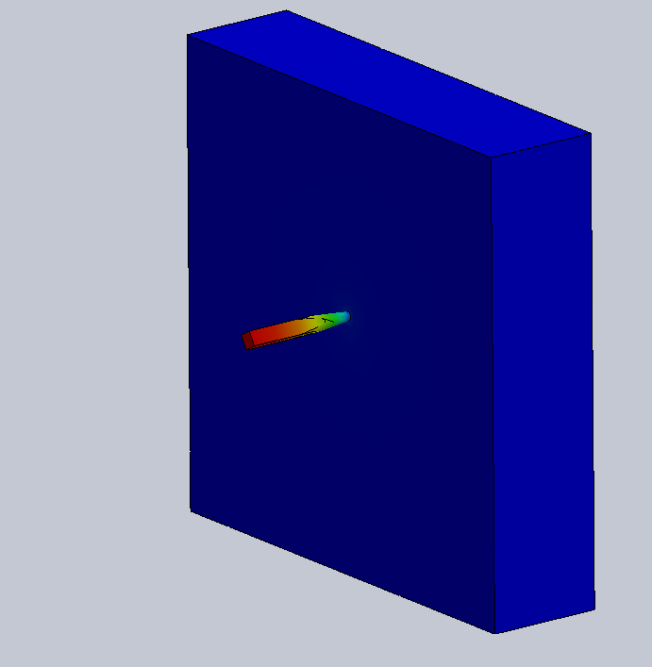
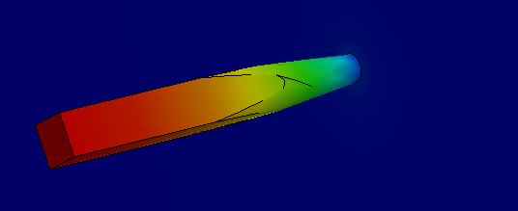
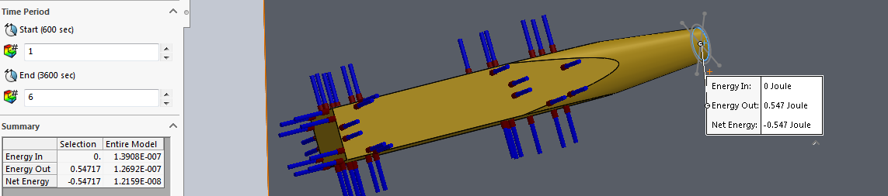
Thermal Conduction Results
1 hour thermal simulation time
Max temperature differential
-100°F to 70°F
0.547 Joules transferred through one standoff
16.41 Joules transferred through 30 standoffs
9.846 Joules transferred in shade
15.316 Joules transferred in sunlight
The net positive energy transfer will be preserved via peltier switching

Slide 14
Power Budget
Power Budget
Subsystem | Power Requirement (J/s) | Energy Consumed in Sun (J) | Energy Consumed in Shade (J)
Communications Power | 2.5 | 8400 | 5400
PMC Power | 0.15 | 591 | 380
DPC Power | 0.095 | 319.2 | 205.2
Solar cell | -12.5 | -42000 | 0
Total energy consumed during 92 min orbit : 15295.4 J
Total energy provided during 92 min orbit: 42000 J
Energy left for additional applications: 26704.6 J
Can fit two more tubes within enclosure - ideally adds up to 133,056 J per pack, good for high impulse applications, however solar input remains the same
Example: COTS industrial camera draws max 5.1 W (max energy consumption of 28152 J during orbit), should be fine for images, video must be limited

Slide 15
Conclusions Regarding Analyses
Analysis | Conclusive? | Aspect Needing Justification | Comments
Air Leakage | Yes | N/A | Additional support via testing in lab would be preferable
Thermal Effects | No | Conduction Convention | Needs experimental evidence
Power Budget | Yes | N/A | Additional support via testing in lab would be preferable

Slide 16
Conclusions Regarding Feasibility
Factors | Currently feasible? | Aspect Not Currently Feasible | Comments
Electrical (DPC, PMC, and batteries) | Yes | N/A | Electrical subsystems are well established and proven to work. Successful Multisim simulation.
Mechanical (tube caddy, core casing, enclosure) | Inconclusive | Conduction Convention | Needs experimental evidence via testing - not yet suitable for purposes other than prototyping
Cost and Logistical Concerns | Inconclusive | Logistics | COVID-19 aside, finding a lab to perform testing has proven difficult due to safety concerns

Slide 17

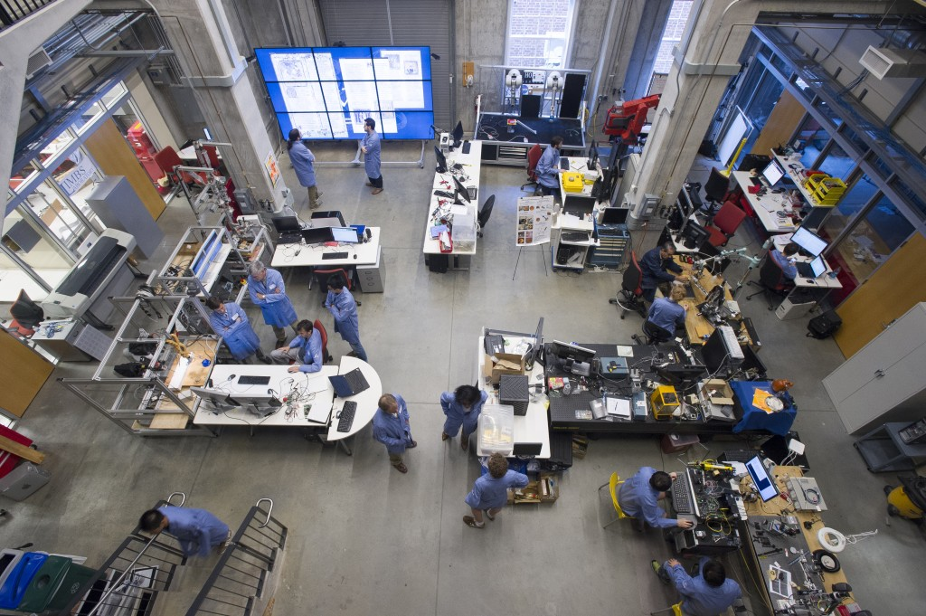
Moving Forward
Open source repository available: contains electrical schematics, mechanical designs, technical specifications, recommended approaches to testing
Logistics: trouble planning testing within well-equipped labs is initially expected, next steps require somewhat rudimentary testing to provide ‘proof of concept’
Open source nature will allow more thorough testing, similar to peer review
If initial testing goes well, ideally perform more robust experimental testing in well-equipped lab
Conclusion: current evidence is not sufficient to build satellite for use purposes but is sufficient motivation to continue testing, recommend not yet making use of modular nature
Ideal path forward: experimental testing → revisions→testing for modular use→ revisions→flight testing

Slide 18
Water Thermal Transfer Test
Components
2 buckets of water, one at temperature A and the other at temperature B
Temperature differential must be 170 degrees Fahrenheit
Fully assembled core with casing segments, o-rings, ceramic feedthrough, and caddy with proper standoffs (These standoffs have sanded tips).
Caddy must have temperature probe adhered to one of its internal surfaces. The electrical conduit for the probe is recommended to be fed through one of the ceramic feedthrough pins
Computer with capability to convert probe voltage to accurate temperature reading (a compactRIO platform by NI is recommended for this experiment)
Procedure
Place one bucket of water with the core fully immersed in a refrigerator for at least 96 hours, and allow the temperature to drop to approximately 35 degrees Fahrenheit. Do not allow the water to freeze
Approximately 1 hour prior to conducting the experiment, ignite a propane heater to begin heating the 2nd bucket of water. The temperature of the heated water must reach approx 205 degrees, or just under boiling temperature.
When temperature of heated water is reached with no more than 5 percent deviation, remove the core from the chilled water and immediately place it into the heated water. Set a timer for 36 minutes. Measure probe temperature in 1 minute increments until the time allotted has expired.

Slide 19
Long-Term Leak Modeling
Components
Vacuum chamber
Fully assembled core with casing segments, o-rings, ceramic feedthrough, and caddy with proper standoffs
Caddy must be assembled with an air pressure sensor to measure the change in pressure in core casing over the duration of the test
Procedure
Prepare vacuum chamber be at a constant temperature of 72℉
Place core casing inside the chamber and remove air
Leave casing in the vacuum chamber for as long as possible
The data collected will be used to model a six-month duration in vacuum. More time spent on this experiment will provide more accurate results.
Record the pressure data and generate a model for six-months

Slide 20
Questions?

Slide 21
Possible cost to Launch?
Would NASA Fund our Tubesat?
-If you build a CubeSat, securing a rocket to launch it on is not difficult, merely expensive. A typical CubeSat launch cost is estimated at $40,000.
-There are several commercial providers promising future CubeSat rockets, assuming they complete development.
-https://makezine.com/2014/04/11/your-own-satellite-7-things-to-know-before-you-go/
-We would have to make a five-minute pitch that we would present to NASA to ask for funding.
-Realistic issues with this?
-https://makezine.com/2014/04/11/your-own-satellite-7-things-to-know-before-you-go/

Slide 22
Things to consider.
-NASA or a company investing in sending our project to space would want guaranteed results.
-Currently we have tests and speculations on how our tubesat would react in the space environment. This is highly dependent on keeping our tube enclosure pressurized as our electronic components will not survive the environment in space.
-Would it be better to have used space rated components vs using off the shelf components?
-As it eliminates the heavy requirement of having to make sure our tube stays pressurized as anything can happen to depressurize it.
-Investing possibly $40,000 to launch the rocket with our tubesat; we would have to be 100% sure it would operate properly and do exactly what we want.

Slide 23
GitHub
https://github.com/MSOSDev/TubeSat

